Slide 1
Network Transmission of Ping Messages using Network Simulator 2
Name
Harsh Satish Patkar
Harshith B Shetty
USN
4NM19EC059
4NM19EC061
Hasini
4NM19EC062
Department of
Electronics & Communication Engineering

Slide 2
Contents
Introduction
Literature Review
Objectives
Methodology
Results
References
Department of ECE
02

Slide 3
Introduction
The Internet Control Message Protocol (ICMP) echo request and ICMP echo reply messages are commonly referred to as ping messages in networking. A ping is a troubleshooting tool used by system administrators to manually evaluate network device connectivity as well as network delay and packet loss.
The ping command makes an ICMP echo request to a network device, which promptly answers with an ICMP echo reply.
When the device receives the response, it suggests that the two devices are linked. Ping can also be used to test for network delay and packet loss. It also reports errors, packet loss, and a statistical summary of the results, which typically includes the minimum, maximum, mean round-trip times, and standard deviation of the mean.
03

Slide 4
Introduction
Packet loss occurs when one or more data packets attempt to reach their destination but are unsuccessful. Network congestion or data transmission problems, which commonly occur over wireless networks, are the two main causes of packet loss.
Network congestion is a cause of packet loss that can affect all types of networks. There is no other choice but to delete packets when data continuously arrives at a router or network segment at a pace that is higher than what can be sent through. A bottleneck is defined as a router or connection that limits the capacity of the whole trip path or of network transit in general.
04

Slide 5
Literature Review
Francisco H.M.B et.al. [1] In this paper, an ICMP protocol version with header suppression was developed to enable Ping to work in underwater environments with acoustic communication. ICMP messages sent from any computer on the Internet now may achieve underwater destinations, which can generate responses and send them back.
The presented solution may be used, for example, in monitoring lakes or oil pipelines. By using an intermediate device, a gateway, the ICMP protocol messages sent from any place on the Internet are suppressed and transmitted to the underwater devices, whose communication is limited by their low computational power and the particular characteristics of underwater communication, like high latency, low transmission rate, high packet loss rate, and others, which compose obstacles for the creation of Internet of Underwater Things.
05

Slide 6
Literature Review
Mitko Bogdanoski et.al. [2] In this, the effects of the ICMP Ping Flood Attack on the wireless network were explored.
More specifically, the behavior of the wireless networks under the attack of different numbers of attackers and different ping packets size is examined.
With the in-depth simulation, found that the wireless networks Quality of Service (QoS) parameters can be dramatically reduced under this type of flooding attack. Also, an increased number of attackers and packet size has different effect on different WLAN QoS Parameters.

Slide 7
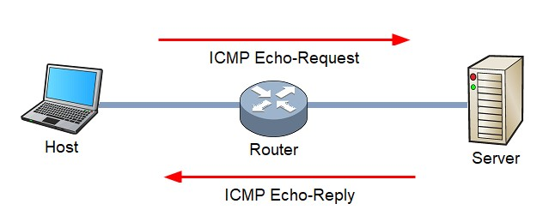
Objectives
To send ping messages across a network, four nodes are assigned as ping agents and they transmit data.
To calculate the round-trip time: After receiving the response, the round-trip time should be calculated.
To count the number of packets dropped due to congestion.
06

Slide 8
Methodology
The program is divided into 2 sub-programs, namely the AWK file and the TCL file. We have considered 6 nodes in the program out of which 4 nodes (n0, n4, n5, n6) are assigned as ping agents and 1 node (n2) is a router. Duplex links between the nodes are created and the queue limit between the nodes is set to 5 (n0 - n2 and n2 - n5), 2(n2 - n6), 3(n2-n4). Next, we attach the nodes to their respective agents, i.e., ping agents. Later a recv is defined, which calculates the round-trip time for the reply received using the built-in function ‘Round Trip Time (RTT)’ and the same is displayed on the screen. Finally, the events have to be scheduled to what event should be triggered at what time.
In the AWK file first, we initialize the count to 0. If there is a drop in the packet, then the count must be incremented. Once all the packet transmission is done, the total number of packets dropped is printed on the screen.
07

Slide 9
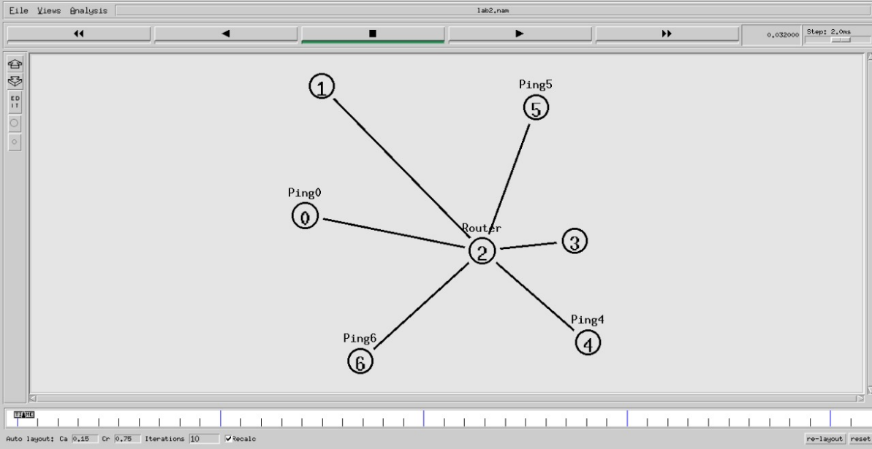
Results
Figure 3.1: Interconnection of nodes
08

Slide 10
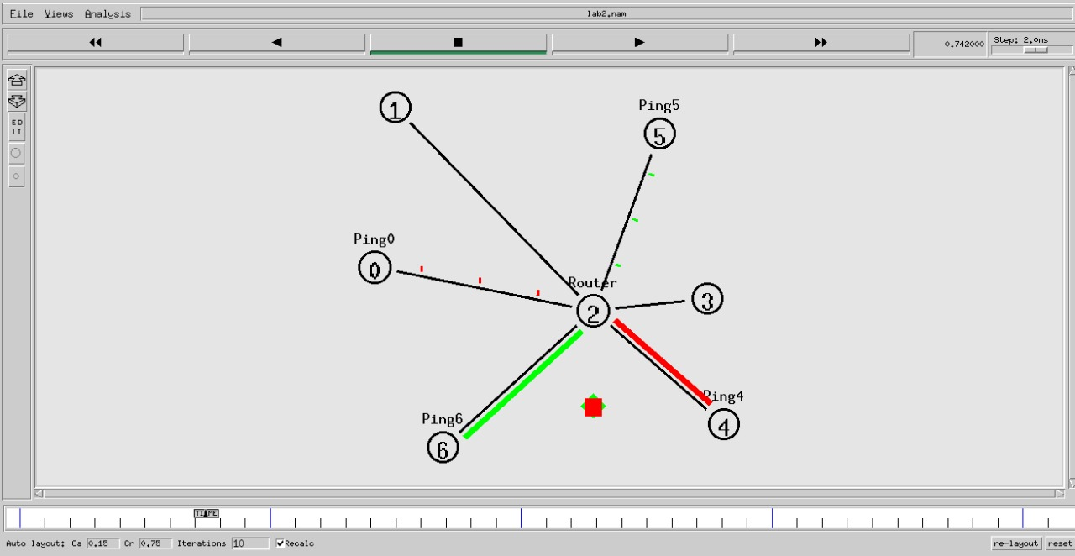
Results
Figure 3.2: Illustration of packet drop
09

Slide 11
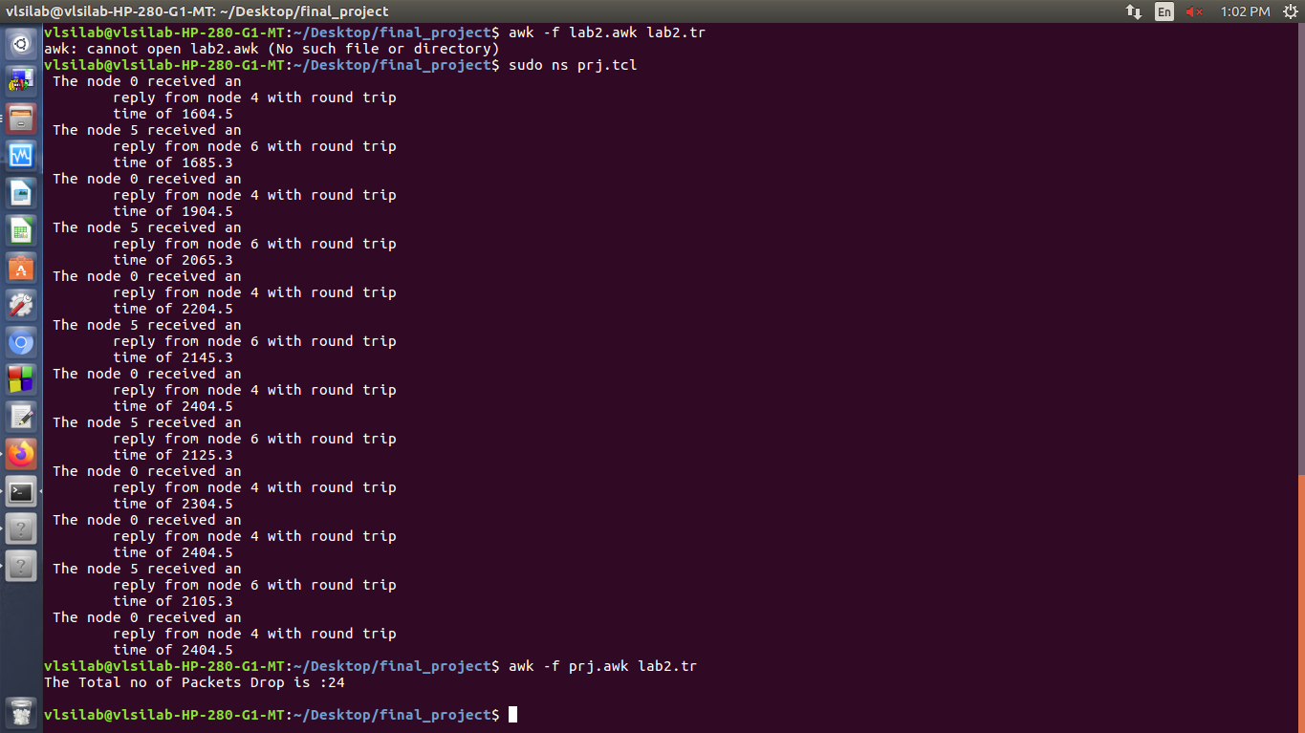
Results
Figure 3.3: Command line output
010

Slide 12
Results
Fig 3.1 shows how the nodes are connected. Fig 3.2 depicts the packet getting dropped due to congestion. As seen from the figure, node 0, node 4, node 5, and node 6 are assigned as ping agents, and node 2 acts as a router. A packet is getting dropped from the router or node 2 due to traffic. Fig 3.3 shows the command line output. When the node receives the echo reply, the program is supposed to measure the roundtrip time and print it. Finally, the count of packets dropped is printed on the screen
011

Slide 13
References
https://www.sciencedirect.com/science/article/abs/pii/S1389128619300246
http://eprints.ugd.edu.mk/6462/1/__ugd.edu.mk_private_UserFiles_biljana.kosturanova_Desktop_Mitko%20Bogdanoski%20-%20Trudovi%20za%20UGD%20Repozitorium_Telekomunikacii%20-%20Kompjuterski%20Nauki_8.%2065-254-1-PB.pdf
ICMP - Echo / Echo Reply (Ping) Message (firewall.cx) [https://www.firewall.cx/networking-topics/protocols/icmp-protocol/152- icmp-echo-ping.html]
https://ieeexplore.ieee.org/abstract/document/1236446
012

Slide 14
Thank You
Department of ECE
013

